Slide 1










Group Project Proposal
Smart Food
Processing &
Export Facility
Industry 4.0 infrastructure designed for zero-waste operations and global export compliance.
AI • IoT • Automation • Blockchain
Muhammad Shoaib Akhter Qadri
Hafiz Muhammad Hamza
Junaid Nazir
Abdul Mohemin
Adal Imtiaz
Group Member
Group Member
Group Member
Group Member
Group Member
01 / 15

Slide 2










Project Overview
Building a future-proof, export-grade smart facility integrated with Industry 4.0 technologies for maximum efficiency.
Vision & Strategy
Product Scope
To establish a world-class smart food processing hub that sets new benchmarks for automation, hygiene, and digital integration.
Comprehensive processing capabilities for diverse food categories with end-to-end quality assurance protocols.
Fresh Fruits & Vegetables
Future-proof industrial design
Packaged Food Products
Data-driven decision making
Value-Added Processing
Scalable modular architecture
Core Goals
Key Benefits
Achieving operational excellence through strict adherence to global standards and waste reduction targets.
Delivering tangible value through optimized resource utilization and advanced traceability systems.
02 / 15
Zero Waste Operations
Operational Efficiency
Global Export Compliance
Cost Control & Savings
Audit-Ready Digital Records
Rapid Throughput & Scale

Slide 3














Industry 4.0 Integrated
Smart Facility Features
Processing Automation
Robotic handling and conveyor orchestration for high-speed throughput and precision sorting.
IoT Sensor Grid
Real-time monitoring of temperature, humidity, vibration, and critical quality assurance metrics.
AI Intelligence Engine
Computer vision for quality control, anomaly detection, and predictive maintenance models.
Blockchain Traceability
Immutable lot-level provenance tracking from farm sourcing to final export port delivery.
ISO 22000 Compliant Architecture
03 / 15

Slide 4



















Technology Deep Dive
Industry 4.0 Architecture Stack
Artificial Intelligence
Computer vision for QC, anomaly detection, and predictive maintenance models.
Internet of Things
Dense sensor network monitoring temperature, humidity, and machine health.
A.I. Engine
IoT Grid
Advanced Automation
Autonomous guided vehicles (AGVs) and robotic pick-and-place systems.
Core Platform
Blockchain Ledger
Robotics
Blockchain
Immutable record keeping for supply chain transparency and audit trails.
99.9%
< 20ms
100%
System
Uptime
Data
Latency
Secure
Transactions
04 / 15

Slide 5















Food Export Supply Chain
End-to-End Visibility from Farm to Global Table
1
2
3
4
5
6
Farm Sourcing
Processing
Quality Check
Packaging
Logistics
Global Market
Grower certification
Geo-tagged lots
Automated wash,
cut, sort & pack
AI-assisted grading
Lab sampling
Smart labeling
MAP sealing
Cold chain monitoring
Customs docs
Import clearance
Retail distribution
Powered by Blockchain Ledger
• Immutable Transparency
05 / 15

Slide 6








Why Fixed Price Contract?
The optimal procurement strategy for minimizing owner risk and ensuring budget certainty.
Risk Profile
Predictability
Project Fit
Lowest Risk
High Certainty
Recommended
Contractor bears overruns
Lump-sum defined cost
Ideal for defined scope
Lump-Sum Payment
Budget Control
Risk Transfer
Single agreed-upon price simplifies financial planning and eliminates variable billing surprises.
Owners have 100% clarity on total expenditure before breaking ground, protecting capital allocation.
The contractor absorbs risks related to material price hikes, labor inefficiencies, and delays.
Standard Construction Fit
Industry Proven
Perfectly suited for standard industrial buildings and equipment installation where scope is well-defined and unlikely to change.
The dominant contract model for food processing facilities, ensuring accountability and adherence to strict export-grade specifications.
"Fixed Price contracts align incentives for efficiency, ensuring the facility is operational on time and within budget."
06 / 15

Slide 7











Fixed Price Advantages
Strategic benefits of the Lump-Sum procurement model for the Owner
Primary Benefit
Budget Certainty
Risk Protection
Clear Deliverables
Fixed total cost known upfront eliminates financial surprises. Payments are linked to defined milestones rather than hourly labor, ensuring capital efficiency.
The Contractor absorbs liability for delays, material price hikes, and productivity issues. The Owner is shielded from market volatility and construction inefficiencies.
Scope is rigidly defined with specific performance guarantees. Facility handover only occurs after all acceptance criteria and quality standards are met.
Risk Allocation Model
Fixed Price vs. T&M
"By locking in the price and scope, we shift the focus from negotiating costs to monitoring quality and schedule performance."
Owner
Contractor Risk (90%)
Owner Risk (Low)
Contractor Risk (High)
— Procurement Strategy Committee
07 / 15

Slide 8









Procurement Strategy
Phased approach to securing the optimal Fixed Price Contract
Q2 2026 - Phase 1
Requirements Gathering
Define technical specifications, lock BoM (Bill of Materials), and establish acceptance criteria.
Contract Award
Fixed Price Execution
Q3 2026 - Phase 2
Bidding Phase
RFP & Evaluation
Vendor Prequalification & RFP
Release Request for Proposal, conduct site visits, and score vendors on technical + commercial fit.
Strategic Objectives
Q4 2026 - Phase 3
Project Scope, Specs & Requirements
Award & Mobilization
Finalize Fixed Price Contract negotiations and commence site mobilization.
Result: A transparent, risk-mitigated path to Project Success.
Project Success
Approved by Steering Committee
08 / 15

Slide 9














Contract Selection Process
Systematic approach to choosing the Fixed Price model
Define Scope & Budget
1
Establish clear project boundaries, deliverables, and initial cost estimations.
2
Evaluate Contract Types
Compare T&M, Cost Plus, and Fixed Price models against risk tolerance.
Select Fixed Price
Strategic decision to lock in costs and transfer risk to the contractor.
4
Tender & Selection
Competitive bidding process to identify the most capable vendor.
Award & Kickoff
5
Finalize contract signing and commence project mobilization phase.
09 / 15

Slide 10
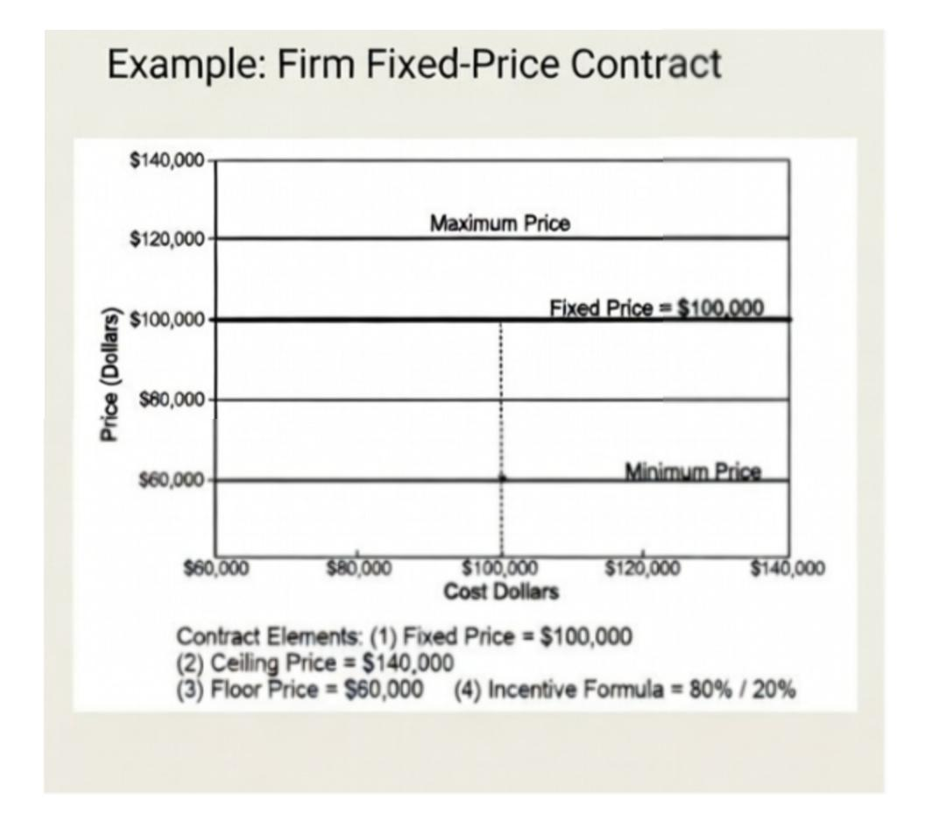

Slide 11









Contract Comparison
Evaluating procurement models against project goals
Contract Type
Owner Risk
Predictability
Flexibility
Verdict
RECOMMENDED
Best for defined scope & budget control.
Fixed Price
Low Risk
Lump Sum / Turnkey
Good for undefined scope or small changes.
Time & Materials
Medium Risk
Unit Rate / Hourly
Not suitable. High uncertainty for owner.
Cost Reimbursable
High Risk
Cost Plus Fee
Recommendation: Fixed Price Contract
Aligns with the project's goal of zero-waste efficiency and strict export compliance, minimizing financial exposure while ensuring on-time delivery.
10 / 15

Slide 12















Risks & Mitigation
Proactive strategies to neutralize project threats and ensure stability
RISK
MITIGATION
RISK
MITIGATION
Cost Overrun
Fixed Price Contract
Equipment Failure
AI Maintenance
Uncontrolled budget expansion due to material price volatility and scope creep.
Lump-sum agreement locks in costs, transferring financial risk to the contractor.
Unexpected machinery downtime leading to production bottlenecks.
Predictive IoT sensors detect anomalies early to schedule repairs without stoppage.
RISK
MITIGATION
RISK
MITIGATION
Supply Disruption
Blockchain Tracking
Non-Compliance
Auto-Inspection
Delays in raw material arrival or cold chain integrity breaches.
Real-time ledger visibility and multi-source vendor strategy ensure continuity.
Failure to meet strict international food safety and export standards.
Computer vision QC systems achieve 99.9% defect detection accuracy.
Residual Risk Level
LOW (Safe)
MEDIUM
HIGH (Critical)
LOW
11 / 15

Slide 13













Sustainability & Zero Waste
Environmental impact targets and circular economy initiatives
Eco Packaging
Waste Reduction
100%
40%
Biodegradable materials
Reduction in landfill
ZERO
WASTE
Target 2030
Energy Efficiency
Water Conservation
30%
35%
Lower kWh per unit
Closed-loop recycling
ISO 14001 Certified
Carbon Neutral Operation
Fair Trade Sourcing
12 / 15

Slide 14


















Key Performance Indicators
Projected operational metrics at full capacity
LIVE DATA STREAM
Quality Accuracy
Waste Diversion
Export Markets
99.9%
100%
50+
+14% vs Industry Std
Target Achieved
Active Destinations
Cost Efficiency
Uptime
Traceability
40%
24/7
100%
OpEx Reduction
Continuous Ops
Blockchain Verified
13 / 15

Slide 15















Strategic Conclusion
Summarizing the path to operational excellence and financial security
Recommended Strategy
Smart Facility
Right Contract
Global Ready
AI-driven automation for maximum throughput
Fixed Price model minimizes owner risk
Zero waste & sustainable operations
IoT sensor network for real-time monitoring
Guaranteed budget certainty & control
Blockchain traceability for export trust
Predictive maintenance reduces downtime
Incentivized timeline for faster delivery
Compliant with EU/US food safety standards
Single point of accountability
Ready for Execution
Approve Strategy
By adopting the Fixed Price approach, we secure the foundation for a world-class smart facility.
14 / 15

Slide 16












Smart Food Processing Facility
THANKYOU
Floor is open for questions
Muhammad Shoaib
Akhter Qadri
Hafiz Muhammad
Hamza
Junaid
Nazir
Abdul
Mohemin
Adal
Imtiaz
Team Lead
Project Manager
Technical Lead
Operations
Quality Assurance
Q&A Session
15 / 15

